Slide 1
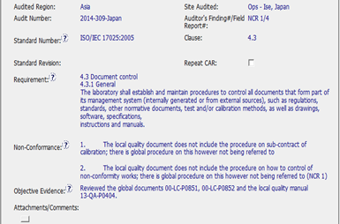

CAR 143914104
Requirement clearly stated
Auditor provide two individual examples of a non-conformance
Objective Evidence indicates the documents that were reviewed

Slide 2

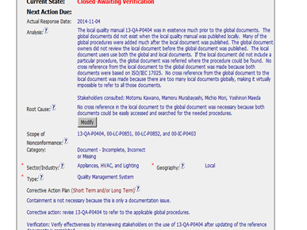
CAR 143914104
The analysis did not specify the type of analysis i.e. 5 why’s, occurrence mapping etc.
The analysis did indicate stakeholders that were consulted
The analysis did not specifically address why there were no procedures identified for subcontracting of calibration service or
non-conforming work, only that there are too many documents globally, making it impossible to search for the needed procedures.
Root cause and analysis do not align.
Why did the defect occur?
Could there be any other procedures that are not referenced?
Analysis did not address what the current process was in place, if any i.ie so how was non-conforming work addressed? Is there a trace back issue?

Slide 3
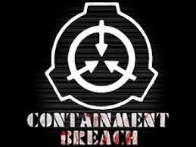
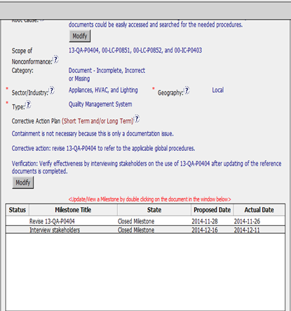
CAR 143914104
Scope of Nonconformance did include the affected records but did not identify the affected location or group (assuming this is applicable).
Containment (or the lack thereof) was addressed.
The corrective action fixed the problem with the lack of a reference but not specifically address preventative recurrence of the defect.
Ideally, there could have been a verification step to ensure the new processes were being following, as opposed or in addition to the current verification which was to interview staff to ensure they were aware of the revision to the laboratory manual and their subjective indication of effectiveness.

Slide 4
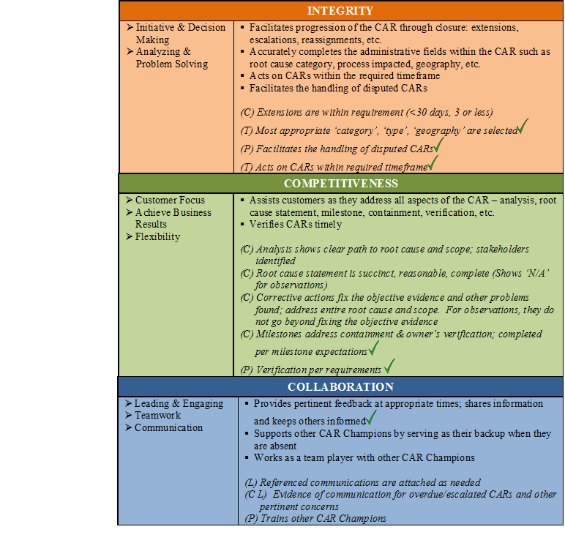

Slide 5
CAR 143914104 Finding

Slide 6
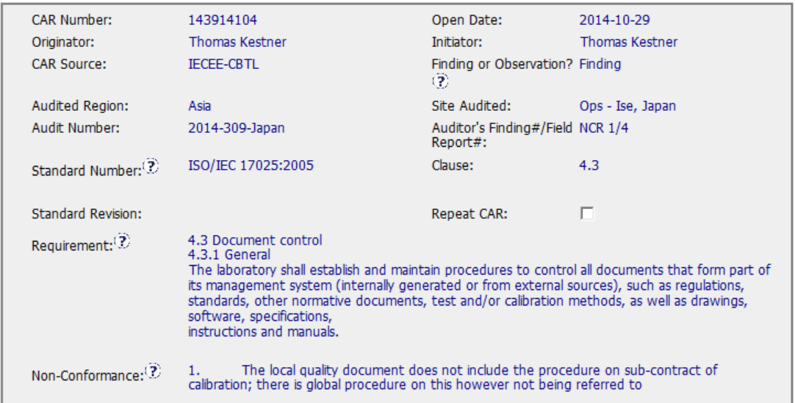
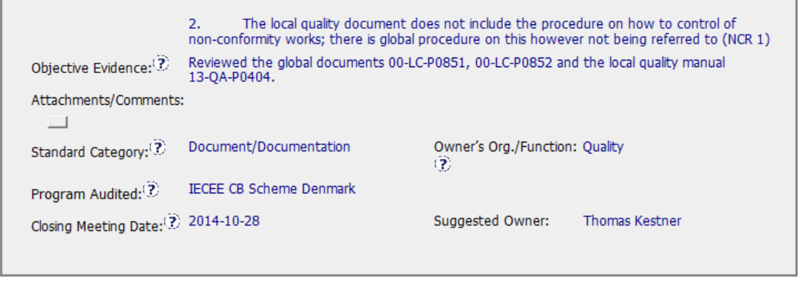

Slide 7
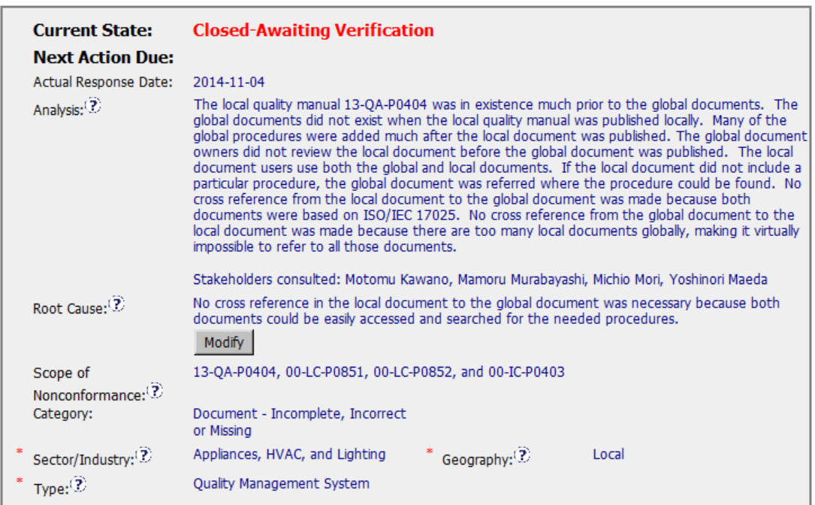
Why? Why wasn’t it
Picked up at the 2 year
Review? Why wasn’t
It revised or obsoleted?)
If using the local doc, why
Didn’t it have all the required
Elements? Which document
Supersedes the other?

Slide 8
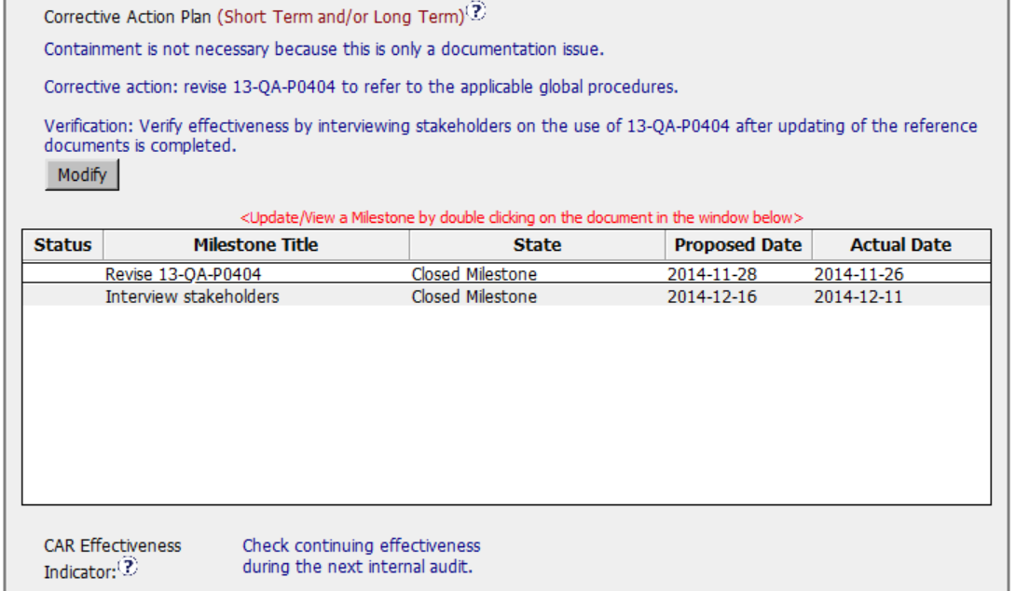

Slide 9
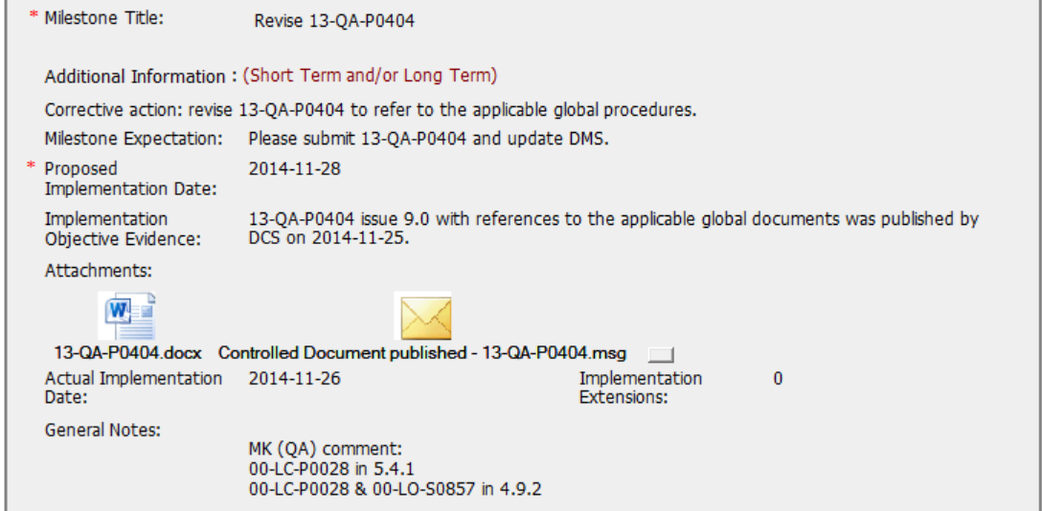
Document is in
Japanese, but references
Are in English. Good that
Note includes paragraphs
That have references.

Slide 10
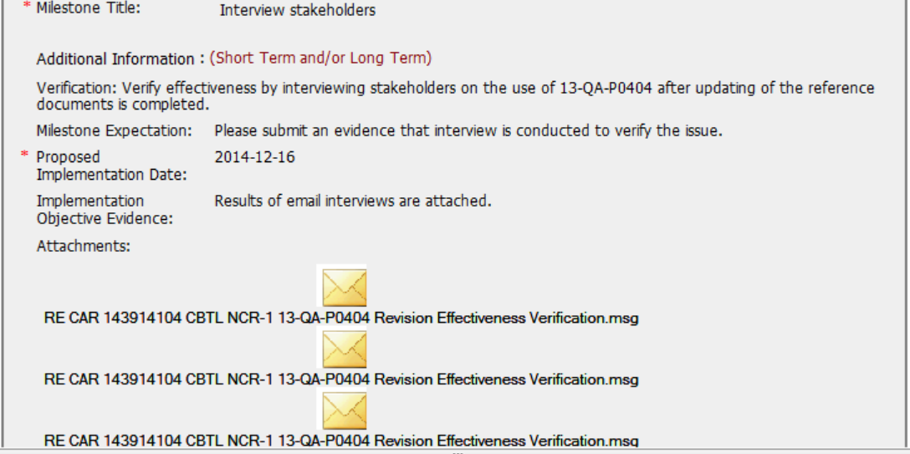
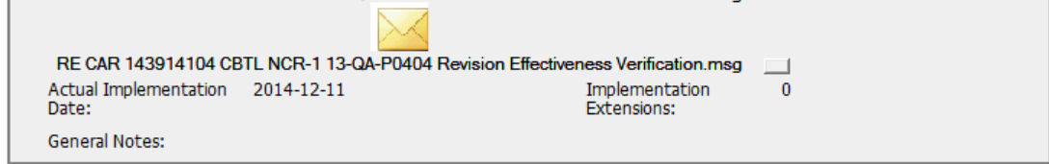
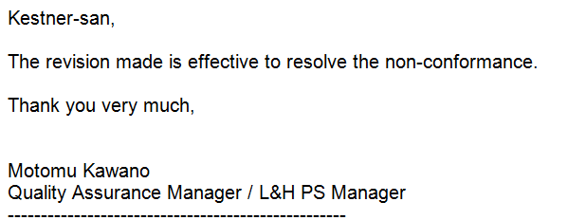
For Verification, I would have expected
Confirmation that staff knew that were aware of
The need to refer to the global documents
for the missing elements of the QMS not addressed
In the local QM. The emails state that they think
The revision is effective to address the
Non-conformance.

Slide 11
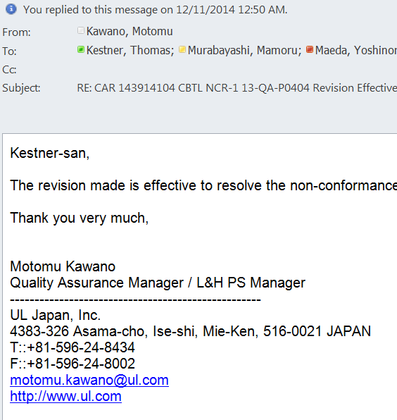

Slide 12
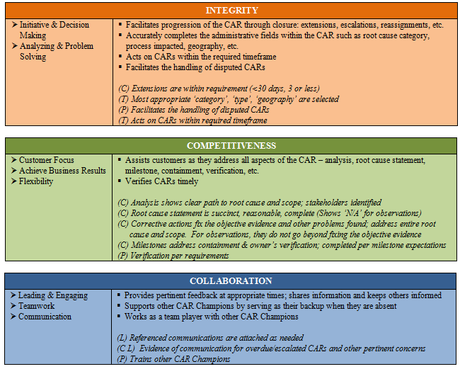


Good collaboration,
But root cause could have
Gone deeper.
Not sure what they verified.

